Slide 1

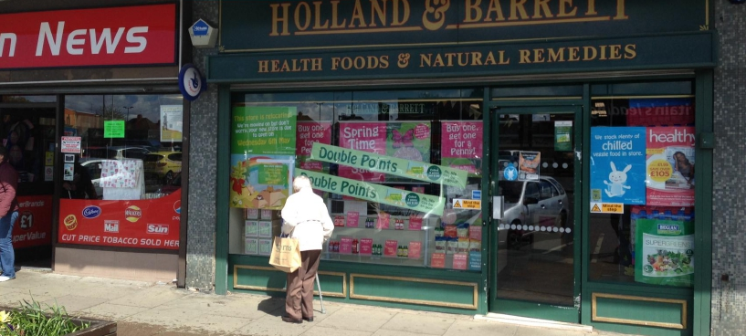
RETAIL UNIT TO LET
RETAIL
Sheldon
2160 Wells Shopping Centre
0
LOCATION
Sheldon is a large suburb of Birmingham. The subject premises are currently located fronting the main A45 Coventry Road, a major arterial route into Birmingham City Centre from Coventry and Birmingham Airport.
The subject property occupies a prominent location within the busy Wells Green Shopping Centre, opposite the car park to the scheme. The property sits adjacent to Sheldon Newsagent and Loans2Go. Other nearby retailers include Lloyds Pharmacy, Iceland, Store Twenty One, Scrivens Opticians, Thomson Travel and Coventry Building Society.
ACCOMMODATION
The property is arranged over ground, first and second floor and offers the
following approximate dimensions and net internal floor areas:
GROUND FLOOR SALES 85 sq m (915 sq ft)
TENURE
The property is available by way of a new full repairing and insuring lease for a
term of years to be agreed at a quoting rental of £30,000 per annum exclusive of business rates and VAT.
RATING INFORMATION
We have been advised by the local rating authority that the current rating
assessment is as follows:
RATEABLE VALUE £21,250
RATES PAYABLE £10,477
We recommend that interested parties make their own enquiries with the local
rating authority to verify these figures.
LEGAL COSTS
Each party is to be responsible for their own legal costs incurred in this transaction.
EPC available upon request
VIEWING
By arrangement via Robertson
Brown Ltd.
Dominic Brown
0121 503 2132
dominic@robertsonbrownuk.com

Slide 2
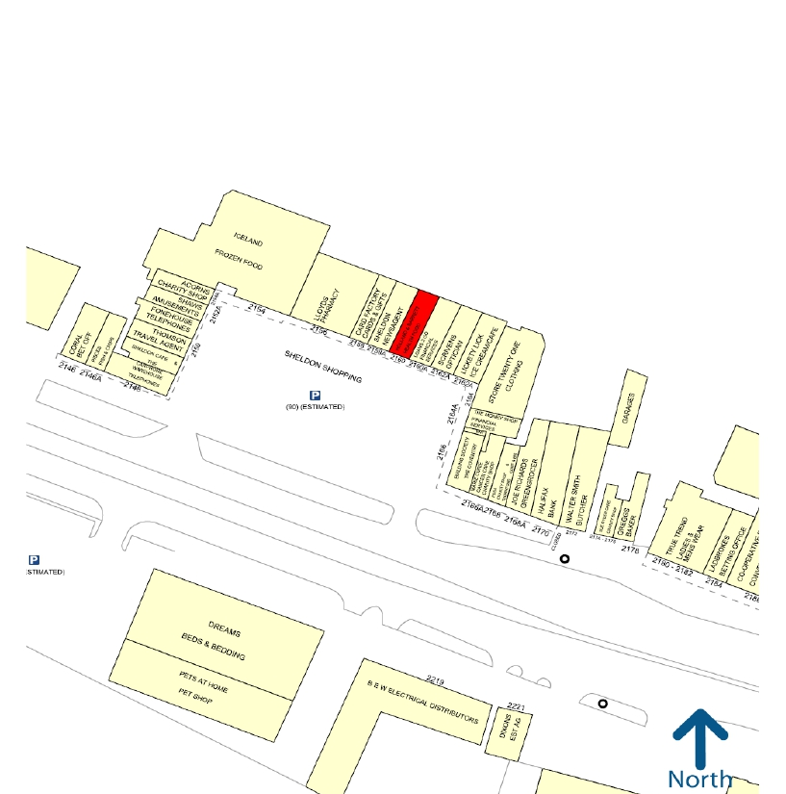
2160 Wells Shopping Centre

